Slide 1
MODULE:I Basics of Software Testing
No. Of Lecture Hours: 10 Hours
Course Start Date: 22.07.19
No.Of Assignment:01

Slide 2
Contents
Basic definitions, Software Quality , Requirements, Behaviour and Correctness, Correctness versus Reliability, Testing and Debugging, Test cases, Insights from a Venn diagram, Identifying test cases, Test-generation Strategies, Test Metrics, Error and fault taxonomies , Levels of testing.

Slide 3
Contents
Introduction
How to equip your resume to search job as tester?
Importance of testing process or software Failures
What do you mean by Testing?
Software Life Cycle Models
Waterfall
Agile
Types of Testing
Functional ( Equivalence,Boundary,Cause Effect,State Transisition)
Structural ( Basics of Graph,control flow,slice,mutation and dataflow)

Slide 4
How to equip your resume for seeking testing job?
Gaining Experience
Perform freelance testing
Usertesting.com
Building Skillset
Searching in Job websites
Identify Skill set
Writing Resume
Templates
Testmyui.com
Whatusersdo.com
Bid Based (Freelancer)
Crowd based(Mobi4hire)
Master those skills

Slide 5
Sample Resumes
https://drive.google.com/drive/folders/1q66tfYeNLw1JV8x2k4fKYGfC56hL6Gdx

Slide 6
Testing Basics
What do you understand by the term “Team” in Software Industry?

Slide 7

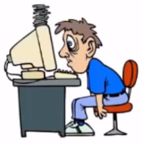

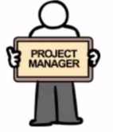




SOFTWARE INDUSTRY TEAM STRUCTURE
Release Engineer
UX Designer
Developer
Project Manager
Product Owner/Client
System Analyst
Tester
DBA
Notes:
Product Owner:
This website is not looking good. It would be great if this particular feature is removed and this new feature is introduced in the website.
UX Designer:
Responsible for site design and colour, would create the dummy page
System Analyst:
Some companies do have specific system analyst….in many organization PM works as system analyst.Writes all the new requirements and make a nice document so everyone knows what is going to be changed.
Developers:
Front and back end developers
Front end deals with making forms buttons etc.
Backend responsible for all the logic…payment processing etc.
Software Tester:
Checks whether the developed software is according to the requirements or not.
Project Manager:
Project is going on time. If there is any hindrance he coordinates with the team to mitigiate it soon.
Release Engineer:
Responsible to make a build .
DBA:
Responsible for taking care of all the data.

Slide 8
MODEL
Waterfall, V shaped, Spiral, Agile

Slide 9
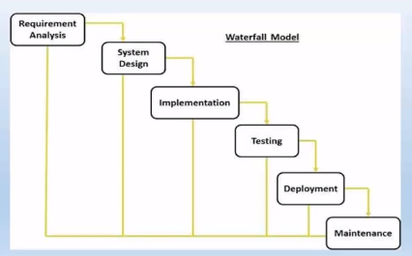

Slide 10
Issues with Waterfall
Requirement Changes
Lack of involvement of customer or business.
Product gets obsolete most of the time.
Accuracy of Estimations.
Last minute of correction is very difficult.
Not much time left for testing or fix the defect.
Lot of Documentation.
Schedule and cost overruns

Slide 11
V-Shaped Model
Commonly referred to as verification and validation model.
Sequential Execution
Testing is planned along with the development.

Slide 12
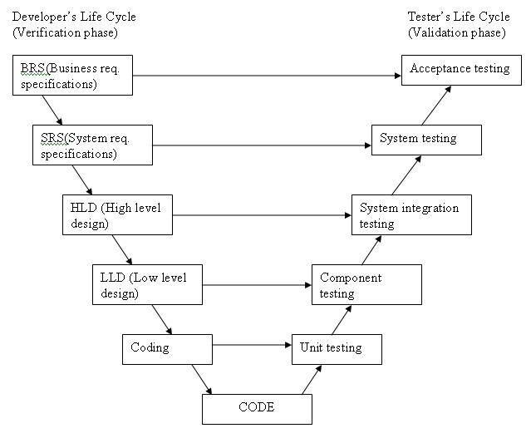
V-Shaped Model

Slide 13
Disadvantages of v-shaped Model
Rigid
Not suitable for large and complex projects.
No early prototypes of the software.

Slide 14
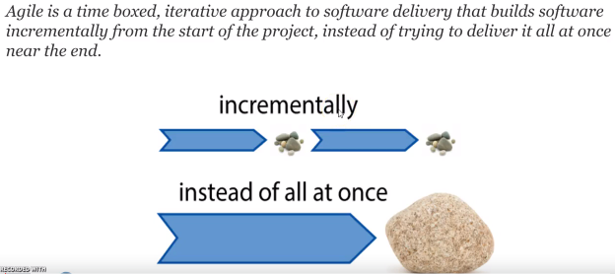
About Agile Methodology

Slide 15
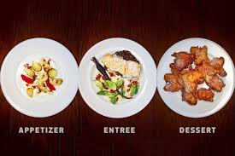
Why Agile is so popular?

Slide 16
What is Scrum?
Scrum is a lightweight agile project management framework mainly used for software development.
It describes an iterative and incremental approach for project work.
Scrum can be used in all kinds of software development:
for developing complete software packages,
for developing only some parts of bigger systems,
for customer or internal projects.

Slide 17
Main Components of Scrum Framework
Roles: Scrum Master, Scrum Product Owner and the Scrum Team
Backlog: containing the end user requirements
Sprints
Scrum Events:
Sprint Planning Meeting (WHAT-Meeting, HOW-Meeting),
Daily Scrum Meeting,
Sprint Review Meeting,
Sprint Retrospective Meeting

Slide 18
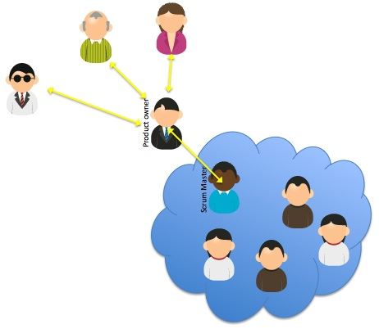
Scrum Roles

Slide 19
Scrum Team
Characteristics
Responsibilities
Share the same norms
Accountability
Self organizing
Balanced set of skill
Small team and no sub teams
Collocation.
Create Sprint Backlog
Short daily Sprint meeting
Potentially shippable functionality is delivered

Slide 20
Scrum Master
Notables
Responsibilities
Servant-leader
Ideal if team selects
Guarding the scrum team
Change Agents
Facilitating Scrum events
Daily scrum meetings
Sprint planning meetings
Sprint review meetings
Sprint retrospective meetings.

Slide 21
Scrum Product owner
Who is it?
Responsibilities
Product+Project
Setting priorities
Managing the Scrum Product Backlog
Release Management
Stakeholder Management
Work closely with the Scrum Team

Slide 22
Scrum framework without project manager
Project Manager activities is needed r not?
Within the Scrum Framework the responsibilities of a project manager are distributed over the roles of the Scrum Product Owner and the Scrum Master.
Functionality, release plan and costs will be effective
One person is responsible for content and planning. .

Slide 23
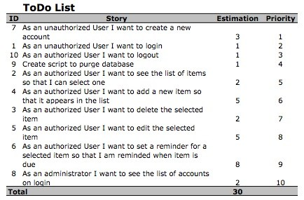
Scrum Product Backlog
List of all things that need to be done in the project
Owner of scrum product backlog is scrum product owner.

Slide 24
Scrum Effort Estimations
Product backlog has to be estimated.
Prioritize the entries and to plan releases.
No single way
Common scale.
Planning Poker/Scrum Poker

Slide 25
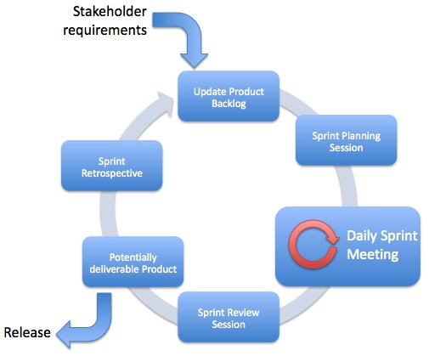
What is Sprint and Sprint Cycle?
all activities needed for the implementation of entries from the Scrum Product Backlog are performed within Sprints (also called 'Iterations’).
Sprints are always short: normally about 2-4 weeks.

Slide 26
What is Sprint Planning meeting?
The Scrum Product Owner defines the Sprint Goal.
Based on this goal the relevant entries in the Scrum Product Backlog are chosen by the Scrum Product Owner.
These entries are updated and broken into smaller stories so that they can be completed within one Sprint.
The entries are estimated & prioritized.
The team defines their capacity for the upcoming Sprint.

Slide 27
Types of Meetings
Daily Scrum Meetings
Sprint Review Meeting
Sprint Retrospective meeting

Slide 28
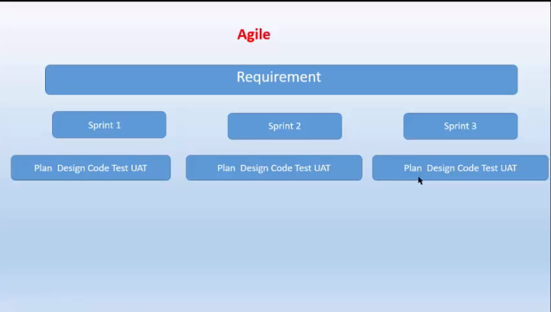
What is Agile Methodology

Slide 29
Advantages of Agile
Understands all requirements can’t be collected at the beginning of the project.
Requirements can be changed throughout the dev cycle.
Customers are completely involved in the dev cycle.
No docs, focus on frequent deliver of the project.
Better visibility and communication.
Test early and often.
Higher quality
Reduced risk and earlier release of software.

Slide 30
Where can I see these agile concepts …Is it only theory?

Slide 31
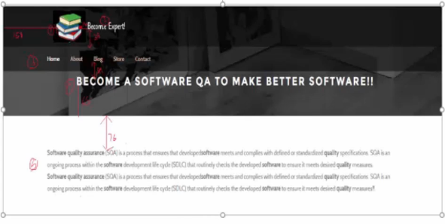

Slide 32
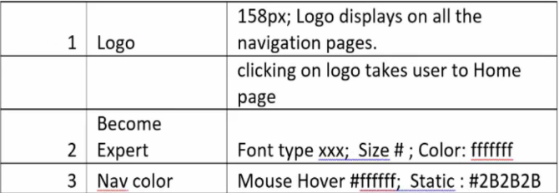

Slide 33
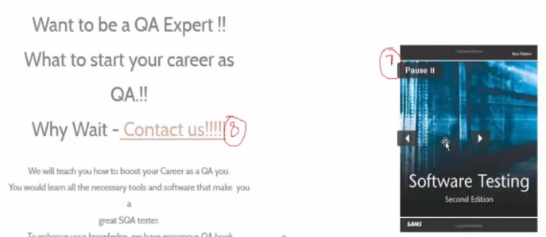

Slide 34
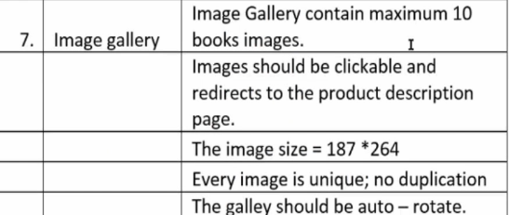

Slide 35
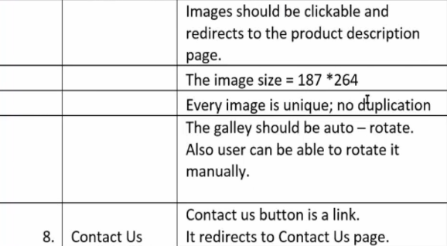

Slide 36


Slide 37
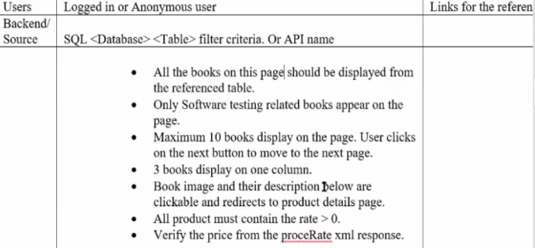
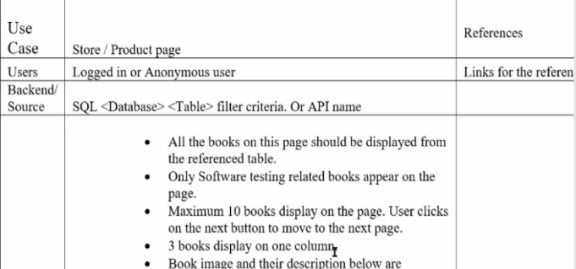

Slide 38
Software Failures

Slide 39
Think of all the programs running on all the computer systems in the world now!
How many of those programs do you rely on to perform correctly every day?
When software fails, how would it affect you or the people you care about?

Slide 40

Ariane Rocket Goes Boom (1996)
Cost: $7 billion
Disaster: Ariane 5, Europes newest unmanned rocket, was intentionally destroyed seconds after launch on its maiden flight. Also destroyed was its cargo of four scientific satellites to study how the Earths magnetic field interacts with solar winds.
Cause: Shutdown occurred when the guidance computer tried to convert the sideways rocket velocity from 64-bits to a 16-bit format. The number was too big, and an overflow error resulted. When the guidance system shut down, control passed to an identical redundant unit, which also failed because it was running the same algorithm.

Slide 41
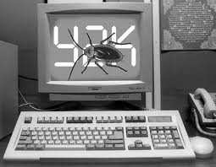
Y2K (1999)
Cost: $500 billion
Disaster: One man’s disaster is another man’s fortune, as demonstrated by the infamous Y2K bug. Businesses spent billions on programmers to fix a glitch in legacy software. While no significant computer failures occurred, preparation for the Y2K bug had a significant cost and time impact on all industries that use computer technology.
Cause: To save computer storage space, legacy software often stored the year for dates as two digit numbers, such as “99″ for 1999. The software also interpreted “00″ to mean 1900 rather than 2000, so when the year 2000 came along, bugs would result.

Slide 42
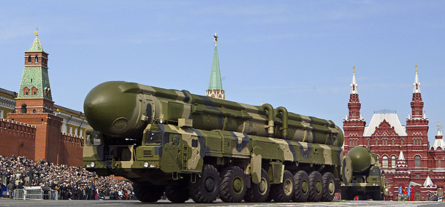
USA star-Wars Program
Cost: Humanity
Disaster: Patroit Missile , used for the first time in Gulf war against the Scud Missile of Iraq. Surprisingly, many times patriot missile failed to hit the targeted Scud Missile. One such failure killed 28 American soldiers in Saudi Arabia.
Cause: There was a slight timing error in the system’s clock after 14 hours of its operation. So tracking was not accurate after 14 hours and this attack happened after the operation of 100 Hours.

Slide 43
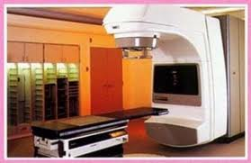
Medical Machine Kills (1985)
Cost: Three people dead, three people critically injured
Disaster: Canada’s Therac-25 radiation therapy machine malfunctioned and delivered lethal radiation doses to patients.
Cause: Because of a subtle bug called a race condition, a technician could accidentally configure Therac-25 so the electron beam would fire in high-power mode without the proper patient shielding.

Slide 44
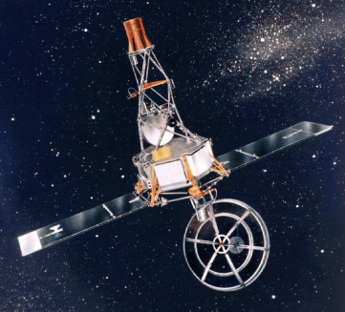
Mariner Bugs Out (1962)
Cost: $18.5 million then
Disaster: The Mariner 1 rocket with a space probe headed for Venus had to be aborted 293 seconds after liftoff
Cause: A programmer confused a period . with a comma , and wrote another correct Fortran program, just not the intended one:
C actual Fortran code:
DO 5 K = 1,3 <- was written
C intended Fortran code:
DO 5 K = 1.3 <- was intended
...
5 CONTINUE

Slide 45
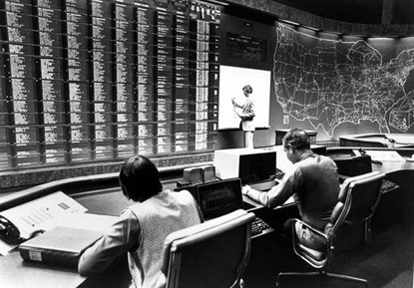
AT&T Lines Go Dead (1990)
Cost: 75 million phone calls missed, 200 thousand airline reservations lost
Disaster: A single switch at one of AT&Ts 114 switching centers suffered a minor mechanical problem and shut down the center. When the center came back up, it sent a message to other switching centers, which in turn caused them to shut down and brought down the entire AT&T network for 9 hours.
Cause: A single line of buggy code in a complex software upgrade implemented to speed up calling caused a ripple effect that shut down the network.

Slide 46

Mars Climate Crasher (1998)
Cost: $125 million
Disaster: After a 286-day journey from Earth, the Mars Climate Orbiter fired its engines to push into orbit around Mars. The engines fired, but the spacecraft fell too far into the planet’s atmosphere, causing it to crash on Mars.
Cause: The software that controlled the Orbiter thrusters used imperial units (pounds of force), rather than metric units (Newtons) as specified by NASA. Nobody during code reviews found this out!

Slide 47
Lessons from Faults
Many of these faults could have been discovered through:
Better requirements/design specifications
So design your projects carefully!
Testing
Unit-level testing
System-wide and regression testing
Because a test was successful in the past doesn’t mean it will stay that way!
Changes in one module might have subtle influence on another
Entire suite of tests must be re-run when a single module is changed
Stress testing
We’ll have more to say on testing later…

Slide 48
Software Failures
Major Problem-develop error free software
If we need certification, then no software will be released.
Not only made a economic impact but also loss of life.

Slide 49
Testing Process
Very important aspect of software Development Life cycle.
Before use, the program is executed with desired input and the output is observed accordingly.
The observed output is compared with the expected output.
If oo and Eo matches then its correct, else there is something wrong in the program.

Slide 50
Minimum Element in a array
#include <stdio.h>
int main()
{
int array[100], minimum, size, c, location = 1;
printf("Enter the number of elements in array\n");
scanf("%d",&size);
printf("Enter %d integers\n", size);
for ( c = 0 ; c < size ; c++ )
scanf("%d", &array[c]);
minimum = array[0];
for ( c = 1 ; c < size ; c++ )
{
if ( array[c] < minimum )

Slide 51
Analysis Data
Test case | Size | Set of Integers | Expected Output | Observed Output | Match
1 | 5 | 6,9,2,16,19 | 2 | 2 | Yes
2 | 7 | 96,11,32,9,39,99,91 | 9 | 9 | Yes
3 | 6 | 31,36,42,16,65,76 | 16 | 16 | Yes
4 | 4 | 6,2,9,5 | 2 | 2 | Yes

Slide 52
Same program-Minimum
Very short list of input with size of 1,2 or 3
An empty list i.e of size 0
A list where the minimum element is the first or last element.
A list where the minimum element is negative.

Slide 53
Analysis Data
Case | Size | Inputs | EO | OO | Match
1 | 1 | 90 | 90 | 2147… | No
2 | 0 | - | Error | 2147… | No
3 | 5 | 10,23,34,81,97 | 10 | 23 | No
4 | 4 | 10,-2,5,23 | -2 | 2 | No

Slide 54
Analysis
Case 1:
Program is not handling the first and last values of the list properly.
Case 2:
The program proceeds without checking the size of the array.

Slide 55
Analysis
Case 3:
Same as case 1
Case 4:
The program converts all negative integers to positive integers

Slide 56
Testing-Definitions
Testing is the process of demonstrating that errors are not present.
The purpose of testing is to show that a program performs its intended functions correctly.
Testing is the process of establishing confidence that a program does what it is supposed to do.

Slide 57
More appropriate Definition
Testing is the process of executing a program with the intent of finding faults.
“To tell somebody that he is wrong is called criticism. To do so officially is called testing”.

Slide 58
Questions that developers ignore
How is the software?
How good it is?
How do u know that it works?
What are the critical areas?
What are the weak areas and why?
What are serious design issue?
What do you feel about the complexity of the source code?

Slide 59
Objectives of testing
Executing a program with the intent of finding an error.
To check if the system is “ Fit for purpose”.
To check if the system does what it is expected to do.
A successful test is one that uncovers a yet undiscovered error.
A good test is not redundant.
A good test should be “best of breed”.
A good test should neither be too simple nor too complex.

Slide 60
Objective of a Software Tester
Find bugs as early as possible and make sure they get fixed.
To understand the application well.
Study the functionality in detail to find where the bugs are likely to occur.
Study the code to ensure that each and every line of code is tested.
Create test cases in such a way that testing is done to uncover the hidden bugs and also ensure that the software is usable and reliable

Slide 61
Responsibilities of a Tester
Product Knowledge
Testing Estimation
Test Plan creation
Test Data Gathering
Test Case Creation
Test Execution
Write the issues and track them
Defect and Status report
Production Support

Slide 62
Why should we test
How much testing is required?
Do we have methods to measure it?
Do we have techniques to quantify it?
“CODE AND FIX”

Slide 63
Who should do the testing
Not a responsibility of a single person.
Depends on the complexity, criticality and functionality.
Testing person should be cautious,curious,critical but non-judgemental and good communicators

Slide 64
Summary
Expected to understand the major software Failures and the impact it provided to the society.
Understand and able to analyze a program.
Perform a test case analysis with different set of inputs for finding the greatest of three numbers.

Slide 65
Let's try to answer this….
What are the disadvantages of Waterfall lifecycle Model?
Who is release engineer?
Define Testing

Slide 66
Some Testing Terminologies/Basic Definitions
Combination of 1st and 3rd Text book

Slide 67
Programs and Software
Program is a combination of source code and object code.
“Software=Program+Documentation+operations”
Requirements | Design | Implementation | Testing
SRS
Software Design Document
Test Suite
Context diagram
ER diagrams
Class Diagrams
Test results
Data Flow Diagrams
Sequence Diagrams
Use case
Use case diagram
Fig: Documentation Manuals

Slide 68
Programs and Software
User Manuals | Operational Manuals
System Overview
Installation Guide
Reference Guide
System Administration Guide
Maintenance Guide
Beginners Guide Tutorial
Terminology and Help manuals

Slide 69
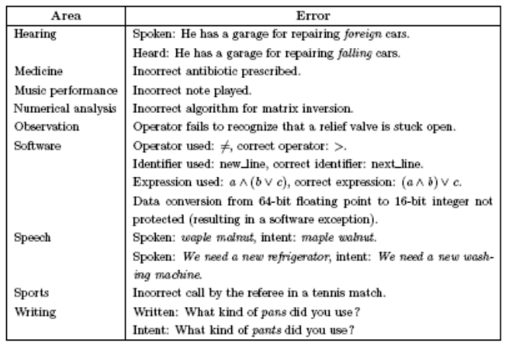

Slide 70
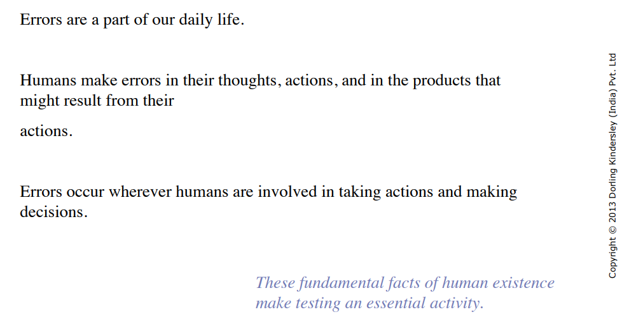

Slide 71
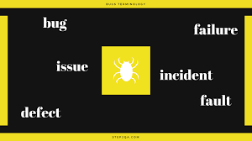
Source:step2qa.com
We use these terms whenever the system/application acts abnormally

Slide 72
Error
“Mistake in coding “
Developer can’t compile or run a program due to a coding mistake in a program.
May be caused by wrong login, loop or due to syntax
Errors tend to propagate; a requirements error may be magnified during design and amplified still more during coding

Slide 73
SRS Error
In SRS it is written as 6+9=20 and our program prints output as 20 when 6 and 9 are inputs.
“Is it a Bug”?
If the same input gives the output as 15, how can we interpret?
In an English like language, one sentence can make 2 different meanings.
Problems in writing good SRS have also become one of the problem of software Testing.

Slide 74
Fault
“Representation of an Error“
error of omission results in a fault in which something is missing that should be present in the representation.
An incorrect step, process or data definition in a computer program which causes the program to perform in an unintended or unanticipated manner
Commission
Fault
Enter Incorrect values into representation
Omission Fault
Fail to enter correct information

Slide 75
“A bat and a ball together costs $1.10cents, the bat costs one dolor more than a ball, how much the ball cost?”

Slide 76
Bug
“Mismatch in application/system in testing phase“
Simply Bug is an error found BEFORE the application goes into production.
A programming error that causes a program to work poorly, produce incorrect results, or crash.
An error in software or hardware that causes a program to malfunction.

Slide 77
Bug-Example
unanticipated user input
To make up a random example, they put their phone number in the driver's license field and their drivers license in the phone field. Then they do a search by drivers license and can't find a user they know exists. I get an email that says, "user search broken."

Slide 78
Defect
“Mismatch in actual and expected results“
The defect is an error found AFTER the application goes into production.
If a developer finds an issue and corrects it by himself in the development phase, then it’s called a defect.

Slide 79
Defect
User finds a grammatical mistake in the naming of the product

Slide 80
Incident
“system exhibits questionable behaviour “
refer to an incident as a defect only when the root cause is some problem in the item, we are testing.
An incident is the symptom associated with a failure that alerts the user to the occurrence of a failure.
Causes of incidents include misconfiguration or failure of the test environment, corrupted test data, bad tests, invalid expected results and tester mistakes

Slide 81
Failure
“Customer find Issues“
A failure occurs when the code corresponding to a fault executes

Slide 82
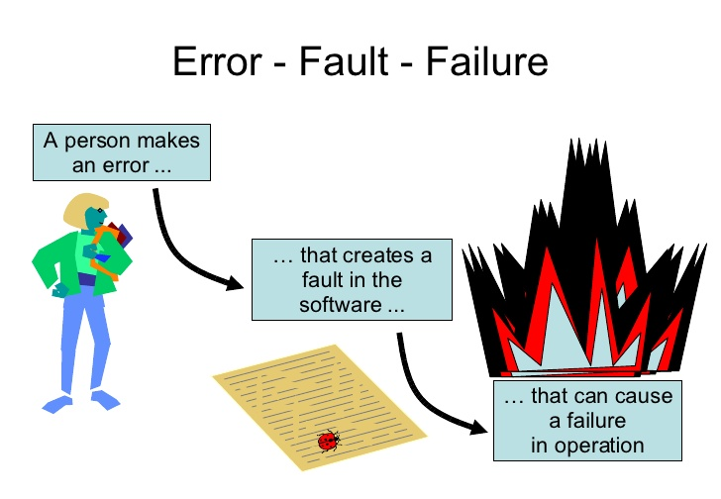
Fault,error,Bug,Failure
“A mistake in coding is called error ,error found by tester is called fault, fault accepted by development team then it is called bug ,build does not meet the requirements then it Is failure.”

Slide 83
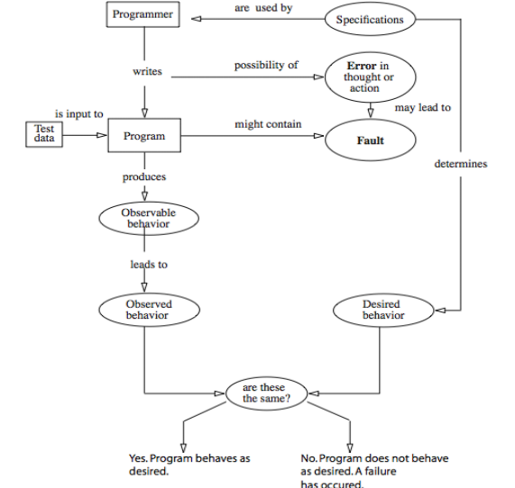
Error,Fault and Failure

Slide 84
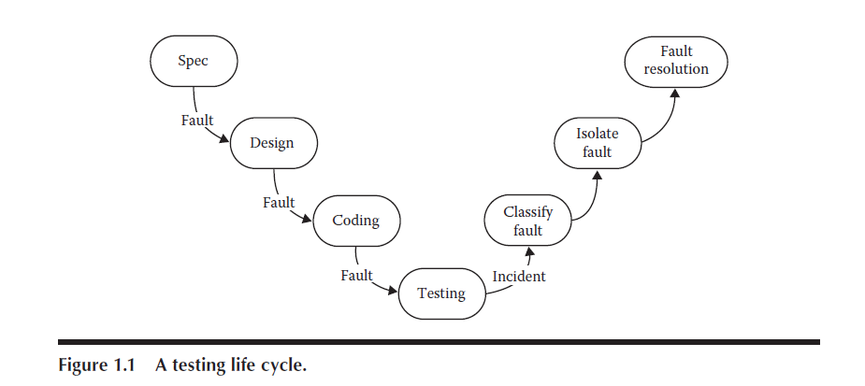

Slide 85
One of the tales of software lore describes a disgruntled employee who writes a payroll program that contains logic that checks for the employee’s identification number before producing pay checks. If the employee is ever terminated, the program creates havoc. Discuss this situation in terms of the error, fault, and failure pattern, and decide which form of testing would be appropriate.

Slide 86
Verification and validation
Criteria | Verification | Validation
Definition | Evaluating work-products | Evaluating the product to check if it meets the business needs.
Objective | Ensure that the product is built according to requirements. | Product fulfills its intended use.
Question | Are we building the product, right? | Are we building the right product?
Evaluation Items | Plans, Requirement Specs, Design Specs, Code, Test Cases | The actual product/software.
Activities | Reviews Walkthroughs Inspections | Testing

Slide 87
Test
Testing is obviously concerned with errors, faults, failures, and incidents.
A test is the act of exercising software with test cases.
A test has two distinct goals: to find failures or to demonstrate correct execution.

Slide 88
Test Case
Test case is a sequence of steps that help us perform a certain test on the application.
What can be the steps?
Before Execution
Purpose
Pre and post conditions
Input and Expected output
After Execution
Output
Pass/fail
Reasons and suggestions

Slide 89
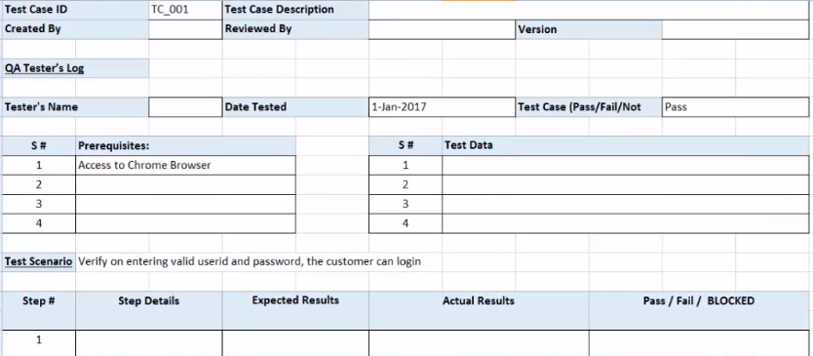
Test Case sample

Slide 90
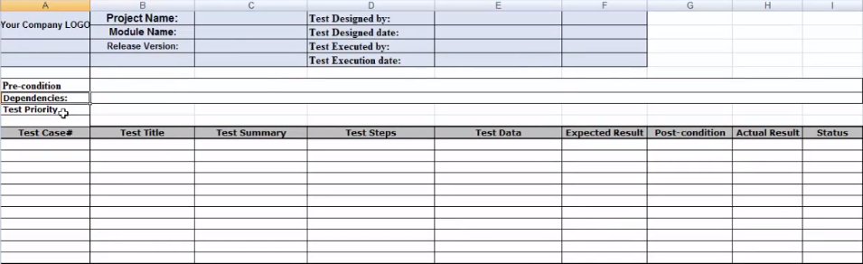
Test Case sample

Slide 91
Test Plan
Test plan is a term and a deliverable.
Test plan is a document that lists all the activities in a QA project, schedules them, defines the scope of the project, roles & responsibilities, risks, entry & exit criteria, test objective and anything else that you can think of.
Test plan is as I like to call a ‘super document’ that lists everything there is to know and need.
“Test plan=mapping of every test case “

Slide 92
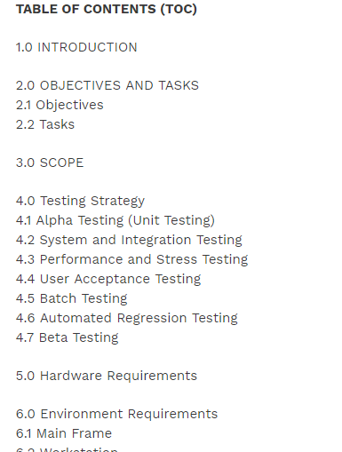
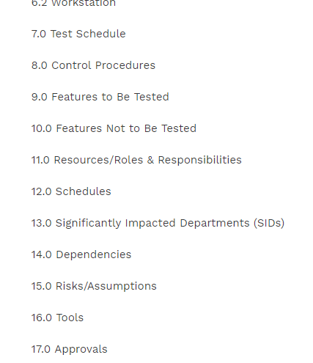
Test Plan

Slide 93
Test Strategy
Test strategy outlines the testing approach and everything else that surrounds it.
It is different from the test plan, in the sense that a Test strategy is only a sub set of the test plan
It is a hard-core test document that is to an extent generic and static.

Slide 94
Test Procedure
Test procedure is a combination of test cases based on a certain logical reason, like executing an end-to end situation or something to that effect.
The order in which the test cases are to be run is fixed.
“Test cases+ sequence following logic= Test Procedure”

Slide 95
Test Procedure
How do you write test procedure to send email using Gmail account?

Slide 96
Test Procedure-Example
Test the sending of an email from Gmail.com, the order of test cases that I would combine to form a test procedure would be:
1. The test to check the login 2. The test to compose email 3. The test to attach one/more attachments 4. Formatting the email in the required way by using various options 5. Adding contacts or email addresses to the To, BCC, CC fields 6. Sending email and making sure it is showing in the “Sent Mail” section
All the test cases above are grouped to achieve a certain target at the end of them. Also, test procedures have a few test cases combined at any point of time.

Slide 97
Test Suite
Test suite, on the other hand, is the list of all the test cases that must be executed as a part of a test cycle or a regression phase etc. There is no logical grouping based on functionality. The order in which the constituent test cases get executed may or may not be important.

Slide 98
Test Suite-Example
If an application’s current version is 2.0. The previous version 1.0 might have had 1000 test cases to test it entirely. For version 2 there is 500 test cases to just test the new functionality that is added in the new version. So, the current test suite would be 1000+500 test cases that include both regression and the new functionality. The suite is a combination too, but we are not trying to achieve a target function.

Slide 99

Software Quality
Personalqa.com
Refer 3rd text book

Slide 100
What do you mean by Quality?

Slide 101
Quality measure whether the software
meets its requirements or not

Slide 102
How do you check if
it meets the requirements or not?

Slide 103
Types of Requirements
Functional requirements
specify what the software should do.
Functional requirements could be calculations, technical details, data manipulation and processing, or any other specific function that defines what an application is meant to accomplish.
Non-functional requirements
specify how the system should work.
Also known as “quality attributes” non-functional requirements include things like disaster recovery, portability, privacy, security, supportability, and usability.

Slide 104
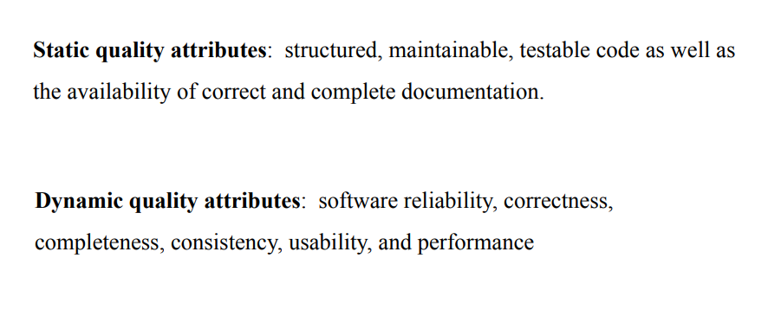
Software Quality

Slide 105
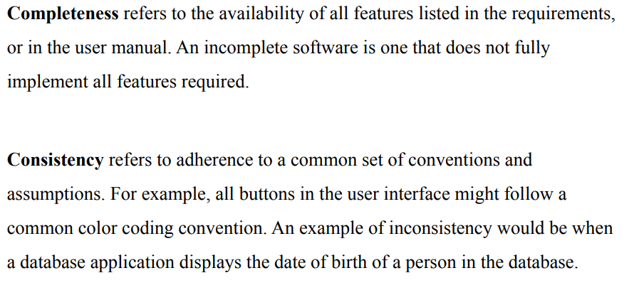
Software Quality-Completeness

Slide 106
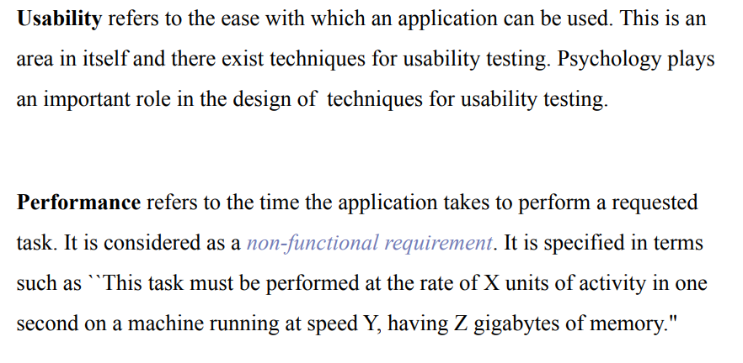
Software Quality-Usability

Slide 107
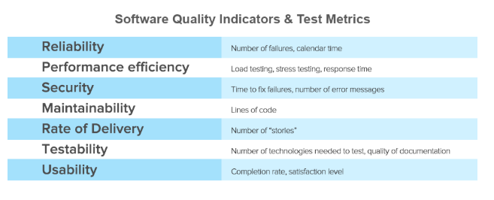
Software Quality
Source :www.altexsoft.comA
Notes:
Reliability→exposed to unfavourable conditions, checking the stability of software…minimal downtime, good data integrity, and no errors that directly affect users.
Performance efficiency refers to an application’s use of resources and how that affects its scalability, customer satisfaction, and response times. Software architecture, source code design, and individual architectural components all contribute to performance efficiency.
Security assesses how well an application protects information against the risk of software breaches. The quantity and severity of vulnerabilities found in a software system are indicators of its security level. Poor coding and architectural weaknesses often lead to software vulnerabilities.
Maintainability is the ease with which you can modify software, adapt it for other purposes, or transfer it from one development team to another. Compliance with software architectural rules and use of consistent coding across the application combine to make software maintainable.

Slide 108
Requirements, Behavior and Correctness
Refer 3rd text book

Slide 109
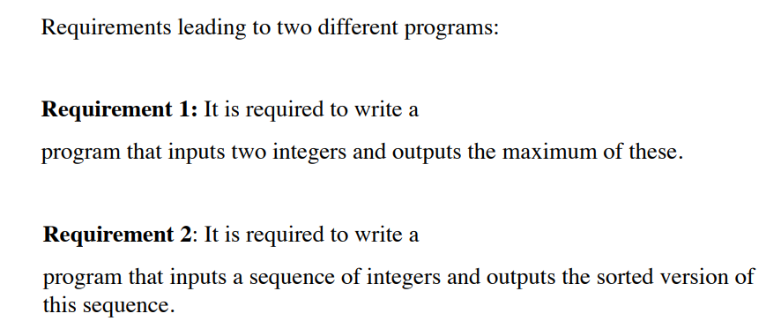
Requirements, Behavior,Correctness

Slide 110
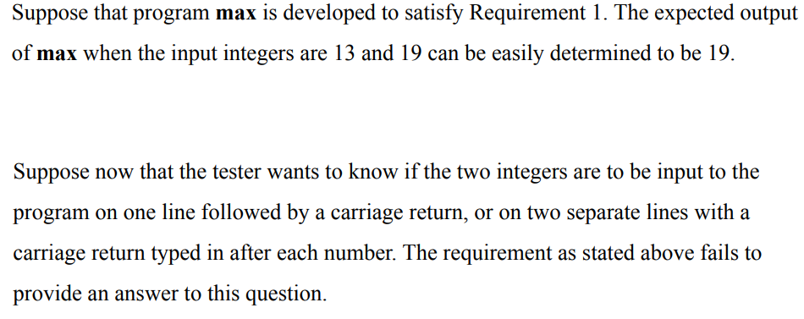
Requirements : Incompleteness

Slide 111
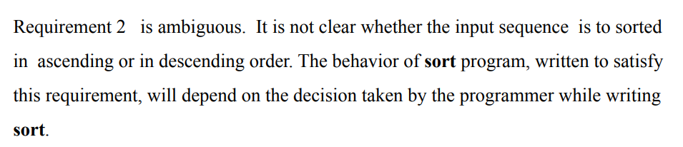
Requirements: Ambiguity

Slide 112
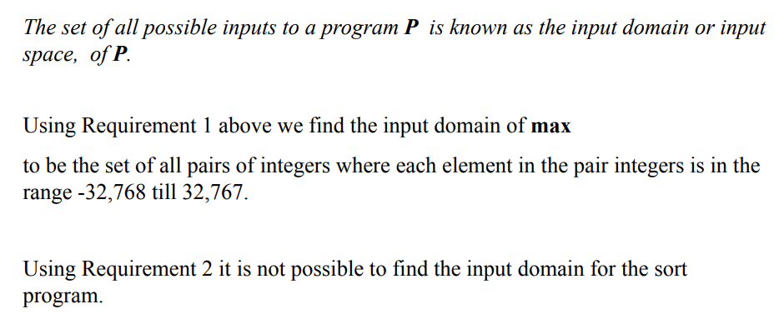
Input Domain(Input Space)

Slide 113
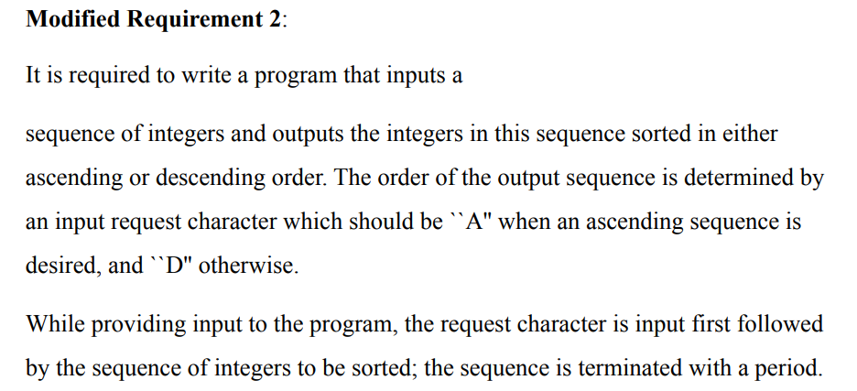
Input Domain(Input Space)

Slide 114
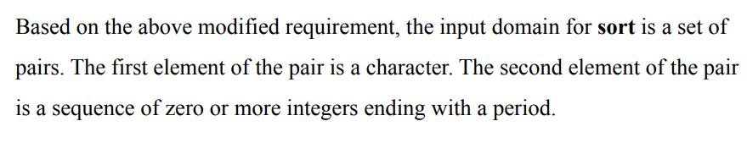
Input Domain(Input Space)

Slide 115
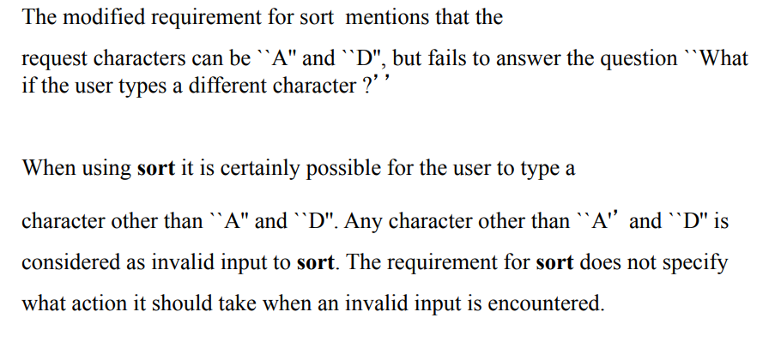
Valid/Invalid Data

Slide 116
Correctness Vs Reliability
Refer 3rd text book

Slide 117
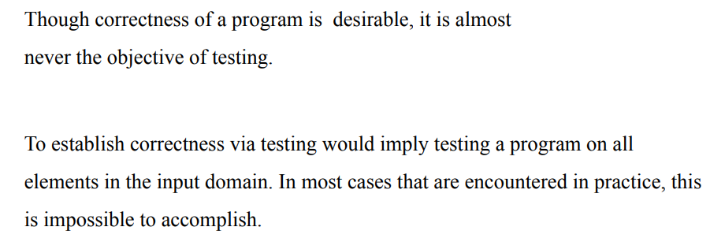
Correctness established via mathematical proofs

Slide 118
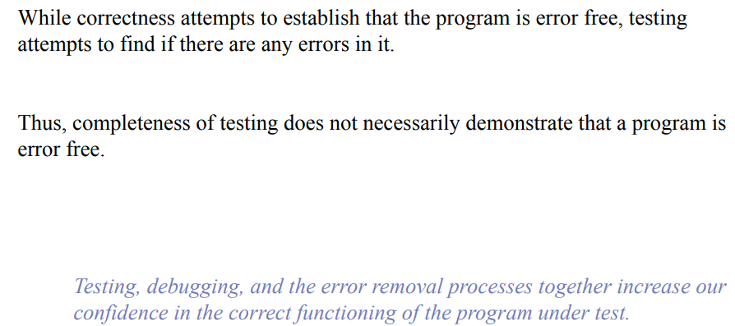

Slide 119
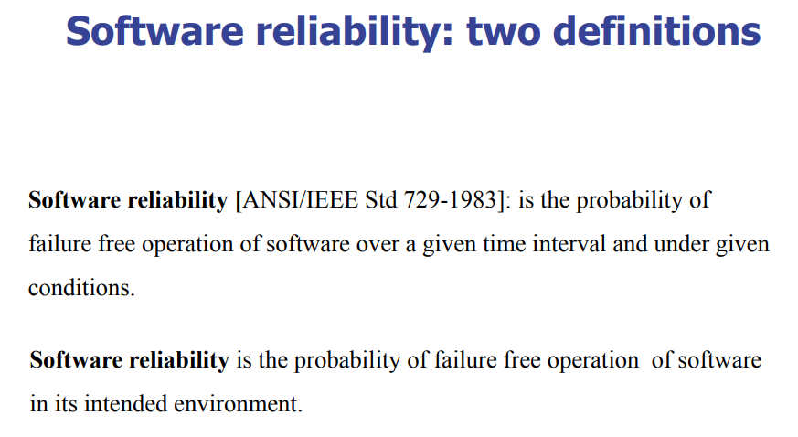

Slide 120
Testing and Debugging
Refer 3rd text book

Slide 121
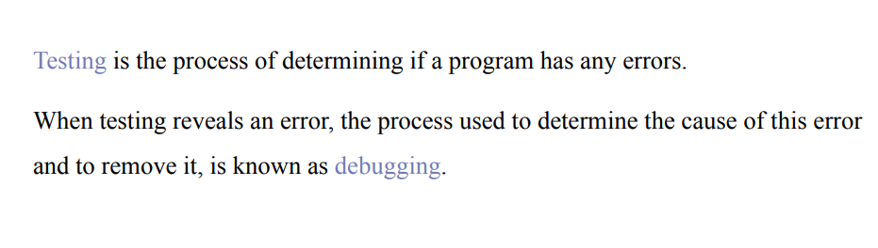

Slide 122
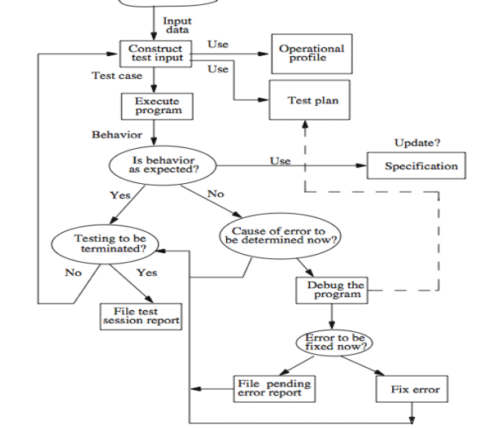

Slide 123
Acceptance Testing
Term used when software is developed for a specific customer.
Customer is involved during acceptance testing.
They create adhoc/well planned test cases and execute them to see the correctness of the software.
This type of testing is called acceptance testing and it is carried out for a month or so, and the errors are fixed

Slide 124
Alpha Testing
These terms are used when we develop software for anonymous customers.
Some potential customers are identified to test the product and the testing is done at the developer’s site by the customer.
Testing is done under a controlled environment and may start when the formal testing process is near completion.

Slide 125
Beta Testing
This is a testing stage followed by internal full alpha test cycle. This is the final testing phase where companies release the software for few external user groups outside the company test teams or employees. This initial software version is called as beta version. Most companies gather user feedback in this release.
You get lot of feedback without any payments.
“ Testing carried out by real users in real environment”

Slide 126
Quality Assurance
After testing if standards are met or not is identified by the Quality Assurance Team.
ISO standards

Slide 127
Limitations
Execute every statement of the program.
Execute every true and false condition.
Execute every condition of a decision node.
Execute every possible path
Execute the program with all the valid inputs
Execute the program with all invalid inputs.
“Everything” is impossible just settle for “less than everything”

Slide 128
Testing can only show bugs are there in the software but can’t show that bugs are not at all there in the software.
“Good Testing cannot make the software better, only good coding with best software engineering principles can make the software better.

Slide 129
Test Cases-Insights from Venn Diagram
Refer 1st Text Book

Slide 130
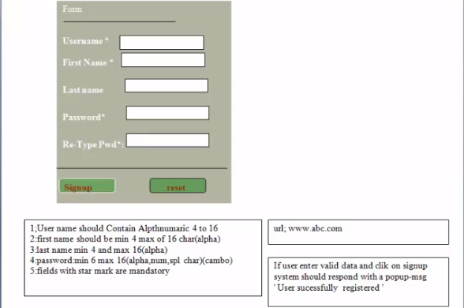

Slide 131
Points from exercise
Testing is behaviour based which is orthogonal to code-based view common among developers.
code-based view focuses on what it is, and the behavioural view considers what it does.
One of the continuing sources of difficulty for testers is that the base documents are usually written by and for developers; the emphasis is therefore on code-based, instead of behavioural, information

Slide 132
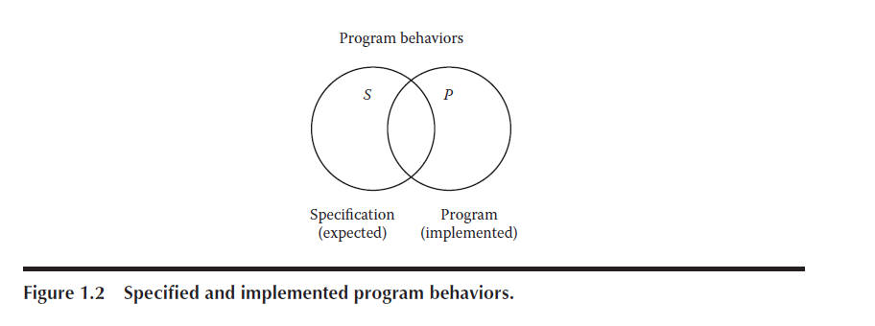
Venn Diagram Usage to test validity
What if certain specified behaviours have not been programmed?
what if certain programmed (implemented) behaviours have not been specified?
Notes:
All program behaviours as universal set….two sets as specified behaviours(S) and other set P of programmed behaviours.. What if certain specified behaviors have not been
programmed?

Slide 133

Venn Diagram Usage to test for validity
specified behaviors that are not tested(region 2 and 5)
specified behaviors that are tested (regions 1 and 4)
test cases that correspond to unspecified behaviors (regions 3 and 7)
there may be programmed behaviors that are not tested (regions 2 and 6)
programmed
behaviors that are tested (regions 1 and 3)
test cases that correspond to behaviors that were not implemented (regions 4 and 7)
Notes:
All program behaviours as universal set….two sets as specified behaviours(S) and other set P of programmed behaviours.. What if certain specified behaviors have not been
programmed?

Slide 134
Let's do Venn diagram for a requirement
God give me the serenity to accept things which cannot be changed; Give me courage to change things which must be changed; And the wisdom to distinguish one from the other.
Notes:
All program behaviours as universal set….two sets as specified behaviours(S) and other set P of programmed behaviours.. What if certain specified behaviors have not been
programmed?

Slide 135

Let's do Venn diagram for a requirement
Notes:
All program behaviours as universal set….two sets as specified behaviours(S) and other set P of programmed behaviours.. What if certain specified behaviors have not been
programmed?

Slide 136
Identifying Test Cases
Refer 1st Text Book

Slide 137
Identify Test cases-Approaches
Functional Testing
Structural Testing

Slide 138

Functional Testing
Function that maps values from input domain to the values in output.
Content of the black box is never understood except in terms of input and output.
Only requirement is the specification document.

Slide 139
Functional Testing
Advantages
Independent Implementation
Reduce project development Interval
Disadvantages
Redundancy among test cases

Slide 140

Functional Testing

Slide 141
Structural Testing
Use internal structure of the software to derive test cases.
Commonly termed as “white box” or “glass box” testing.
Requires strong theoretical Basis.
Test Coverage Metrics to explicitly state the extent the software has been tested.
Can be used at all levels of testing like component testing, component integration testing, and system and acceptance testing.

Slide 142

Structural Testing

Slide 143
Functional Verses Structural Debate
About Structural Testing
Robert Poston Writes
“ Wasting tester’s time since 1970’s does not support good software testing practice and should not be in the tester’s toolkit”
Edward Miller
“Branch coverage if attained 85% or more, tends to identify twice the number of defects that would have been found by ‘intuitive’ testing.

Slide 144

Functional Verses Structural Debate

Slide 145
Which is better?
There is no single rule which can say whether white or black box is better.
QA has to concentrate on functional more than that of coding approach, however to be an efficient QA coding knowledge helps.
Developer/ unit tester will concentrate more on white box testing strategies.

Slide 146
Which is better?
Much of white-box testing is involved with coverage, making sure we have tested everything we need to based on the context of project needs.
Using white-box testing on top of black-box testing allows us to measure the coverage we got and add more testing when needed to make sure we have tested all of the important complexity we should.

Slide 147
Test case writing
Consider the FB page
Write test cases for testing the logging in
Functionality.

Slide 148

Test case writing

Slide 149

Test case writing

Slide 150
Test Generation Strategies
Multiple Sources

Slide 151

Test Generation Strategy

Slide 152

Test Generation Strategy

Slide 153

Test Generation Strategy

Slide 154


Slide 155
Test Data Generation
Structural Testing | Performance Testing | Security Testing | Black Box Testing | Automated Test Data
Decision Coverage | Response time | Malicious Content | Code not visible | Test Generation Tools
Path Coverage | Sample data “real or alive” | Confidentiality-SSL | Valid/invalid | GSApps
Negative API Testing | Customers | Authorization and Authentication | Boundary,Equivalence | DTM

Slide 156
Test Metrics
Multiple sources mainly ReQtest

Slide 157
What if no test metric?
How do you measure the work done by
Test Analyst?

Slide 158
Test Metrics
If something cannot be measured,
It cannot be improved

Slide 159
Why do we need test metrics?
To measure the quality of software

Slide 160
Through test metrics….
Effectiveness and efficiency of
Software testing process

Slide 161
Testing Metrics
Measure various attributes of a product
And quality assurance process

Slide 162
Testing Metrics-Major classification
Base Metrics
Data during test case development and execution
Calculated Metrics
Data gathered in Base Metrics

Slide 163


Slide 164
Parameters essential in selecting Test Metrics
Gives Insight of the business value
Measure Effectiveness
Measure Efficiency
Cost Related

Slide 165

Burn Down Chart
Source:ReQTest.com

Slide 166
Test case execution percentage
Percent of Test Case Execution = {(Number of Passed Test Cases + Number of Failed Test Cases + Number of Blocked Test Cases)/Total Number of Test Cases} *100
100% during delivery

Slide 167
Defect Density
Defect Density = Total Number of defects/Total lines of code
Not count of defects
Overall reduction in defect density gives better product

Slide 168
Defect Detection Percentage
DDP = (Number of Defects detected in a Phase / Total Number of defects in that Phase) x 100
Overall quality of the testing process
Good DDP means good testing

Slide 169
Mean Time to Detect
MTTD = Number of issues detected/Total execution time
Total number of defects and issues

Slide 170
Mean Time to Repair
MTTR = Number of issues fixed/Total coding team

Slide 171
Defect Leakage
Defect Leakage = (No. of Defects found in UAT / No. of Defects found in QA testing.) * 100

Slide 172

Defect Leakage
Defect Leakage = (No. of Defects found in UAT / No. of Defects found in QA testing.) * 100

Slide 173
Defect Leakage
Defect Leakage = (No. of Defects found in UAT / No. of Defects found in QA testing.) * 100

Slide 174

Defect Leakage

Slide 175

Defect Leakage

Slide 176
Fault Taxonomies
Refer 1st Text Book

Slide 177
Is testing product oriented or
Process oriented?

Slide 178
Tester
Finding faults in product
SQA
Typically improves product by improving process

Slide 179
How can we easily identify possible
reasons for failure?

Slide 180
When we know that is failure and
We also know why that is called as failure

Slide 181
When we know that is fault and
We also know why that is called as fault
Who can do this for us?
“Error and Fault Taxonomies”

Slide 182
What is Error and Fault Taxonomy?
large number of potential faults/bugs can be grouped into few categories
Whenever a new fault/bug is reported, using bug’s taxonomy, a tester can easily analyse and put that bug into any of these categories.

Slide 183



Slide 184



Slide 185


Slide 186
Levels of Testing
Refer 1st Text Book

Slide 187
Levels of Testing
Functional
Unit
Integration
System
Regression
Acceptance
Alpha
Beta

Slide 188
Levels of Testing
Non-Functional
Performance
Load
Stress
Usability
Portability

Slide 189
Summary of Module 1
Basic definitions, Software Quality , Requirements, Behaviour and Correctness, Correctness versus Reliability, Testing and Debugging, Test cases, Insights from a Venn diagram, Identifying test cases, Test-generation Strategies, Test Metrics, Error and fault taxonomies , Levels of testing.

